Slide 1


Ending Homelessness in Illinois: Home Illinois
Christine Haley, Chief Homelessness Officer
DCEO Home Illinois Webina
March 20, 2024

Slide 2


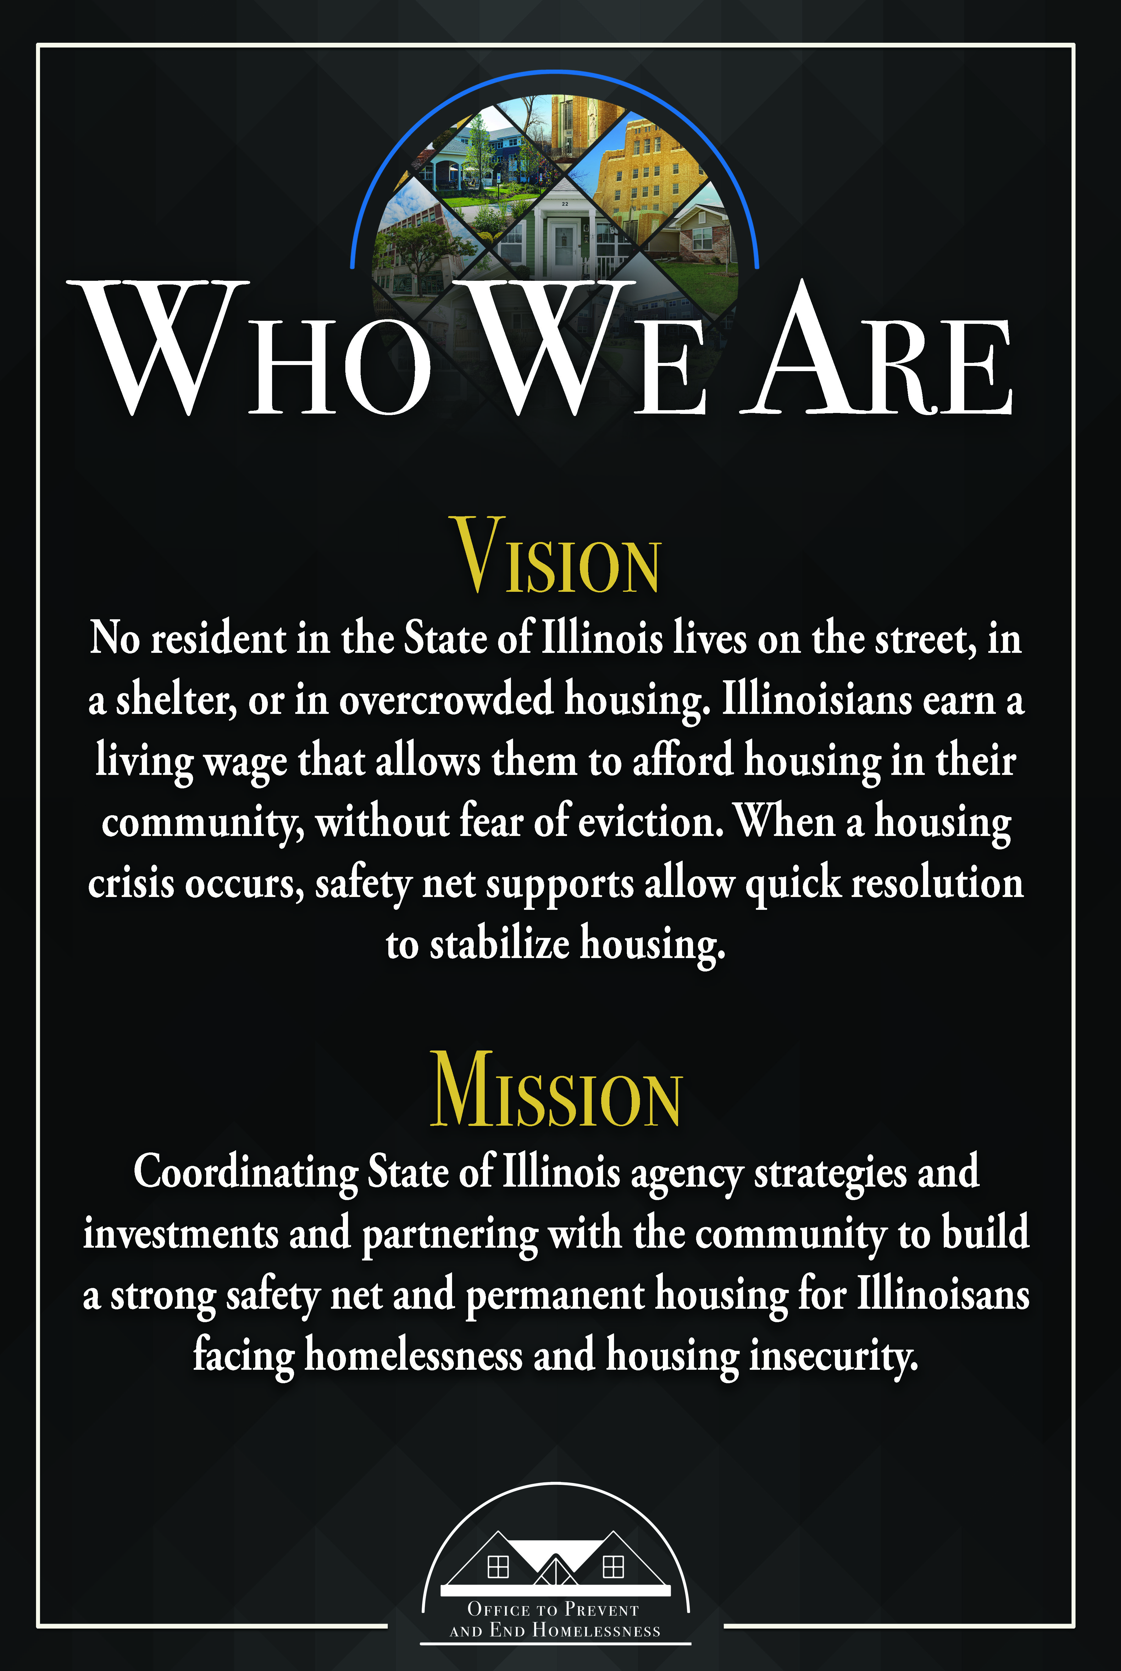
Notes:
Sol

Slide 3

Current Landscape of Homelessness in Illinois

Slide 4
Homelessness by the Numbers: 120,857 Persons Annually
Annually, 44,063 people in 27,733 households are served in Illinois’ literal homeless system, of whom an estimated:
  18% live with severe mental illnesses
  12% lie with chronic substance use
  5% are veterans
  8% are survivors of domestic violence
  6% are youth ages 18-24
  5% Are parenting youth or children of parenting youth
76,794 children, from infants through 12th grade, experienced doubled-up homelessness in 2020-21 school year
FY22 IDHS funded emergency shelter turn-aways: 9,837 individuals and 2,651 children
11% of the state’s total estimated literally homeless population are from rural CoCs: 4,568 people
Notes:
Sol

Slide 5
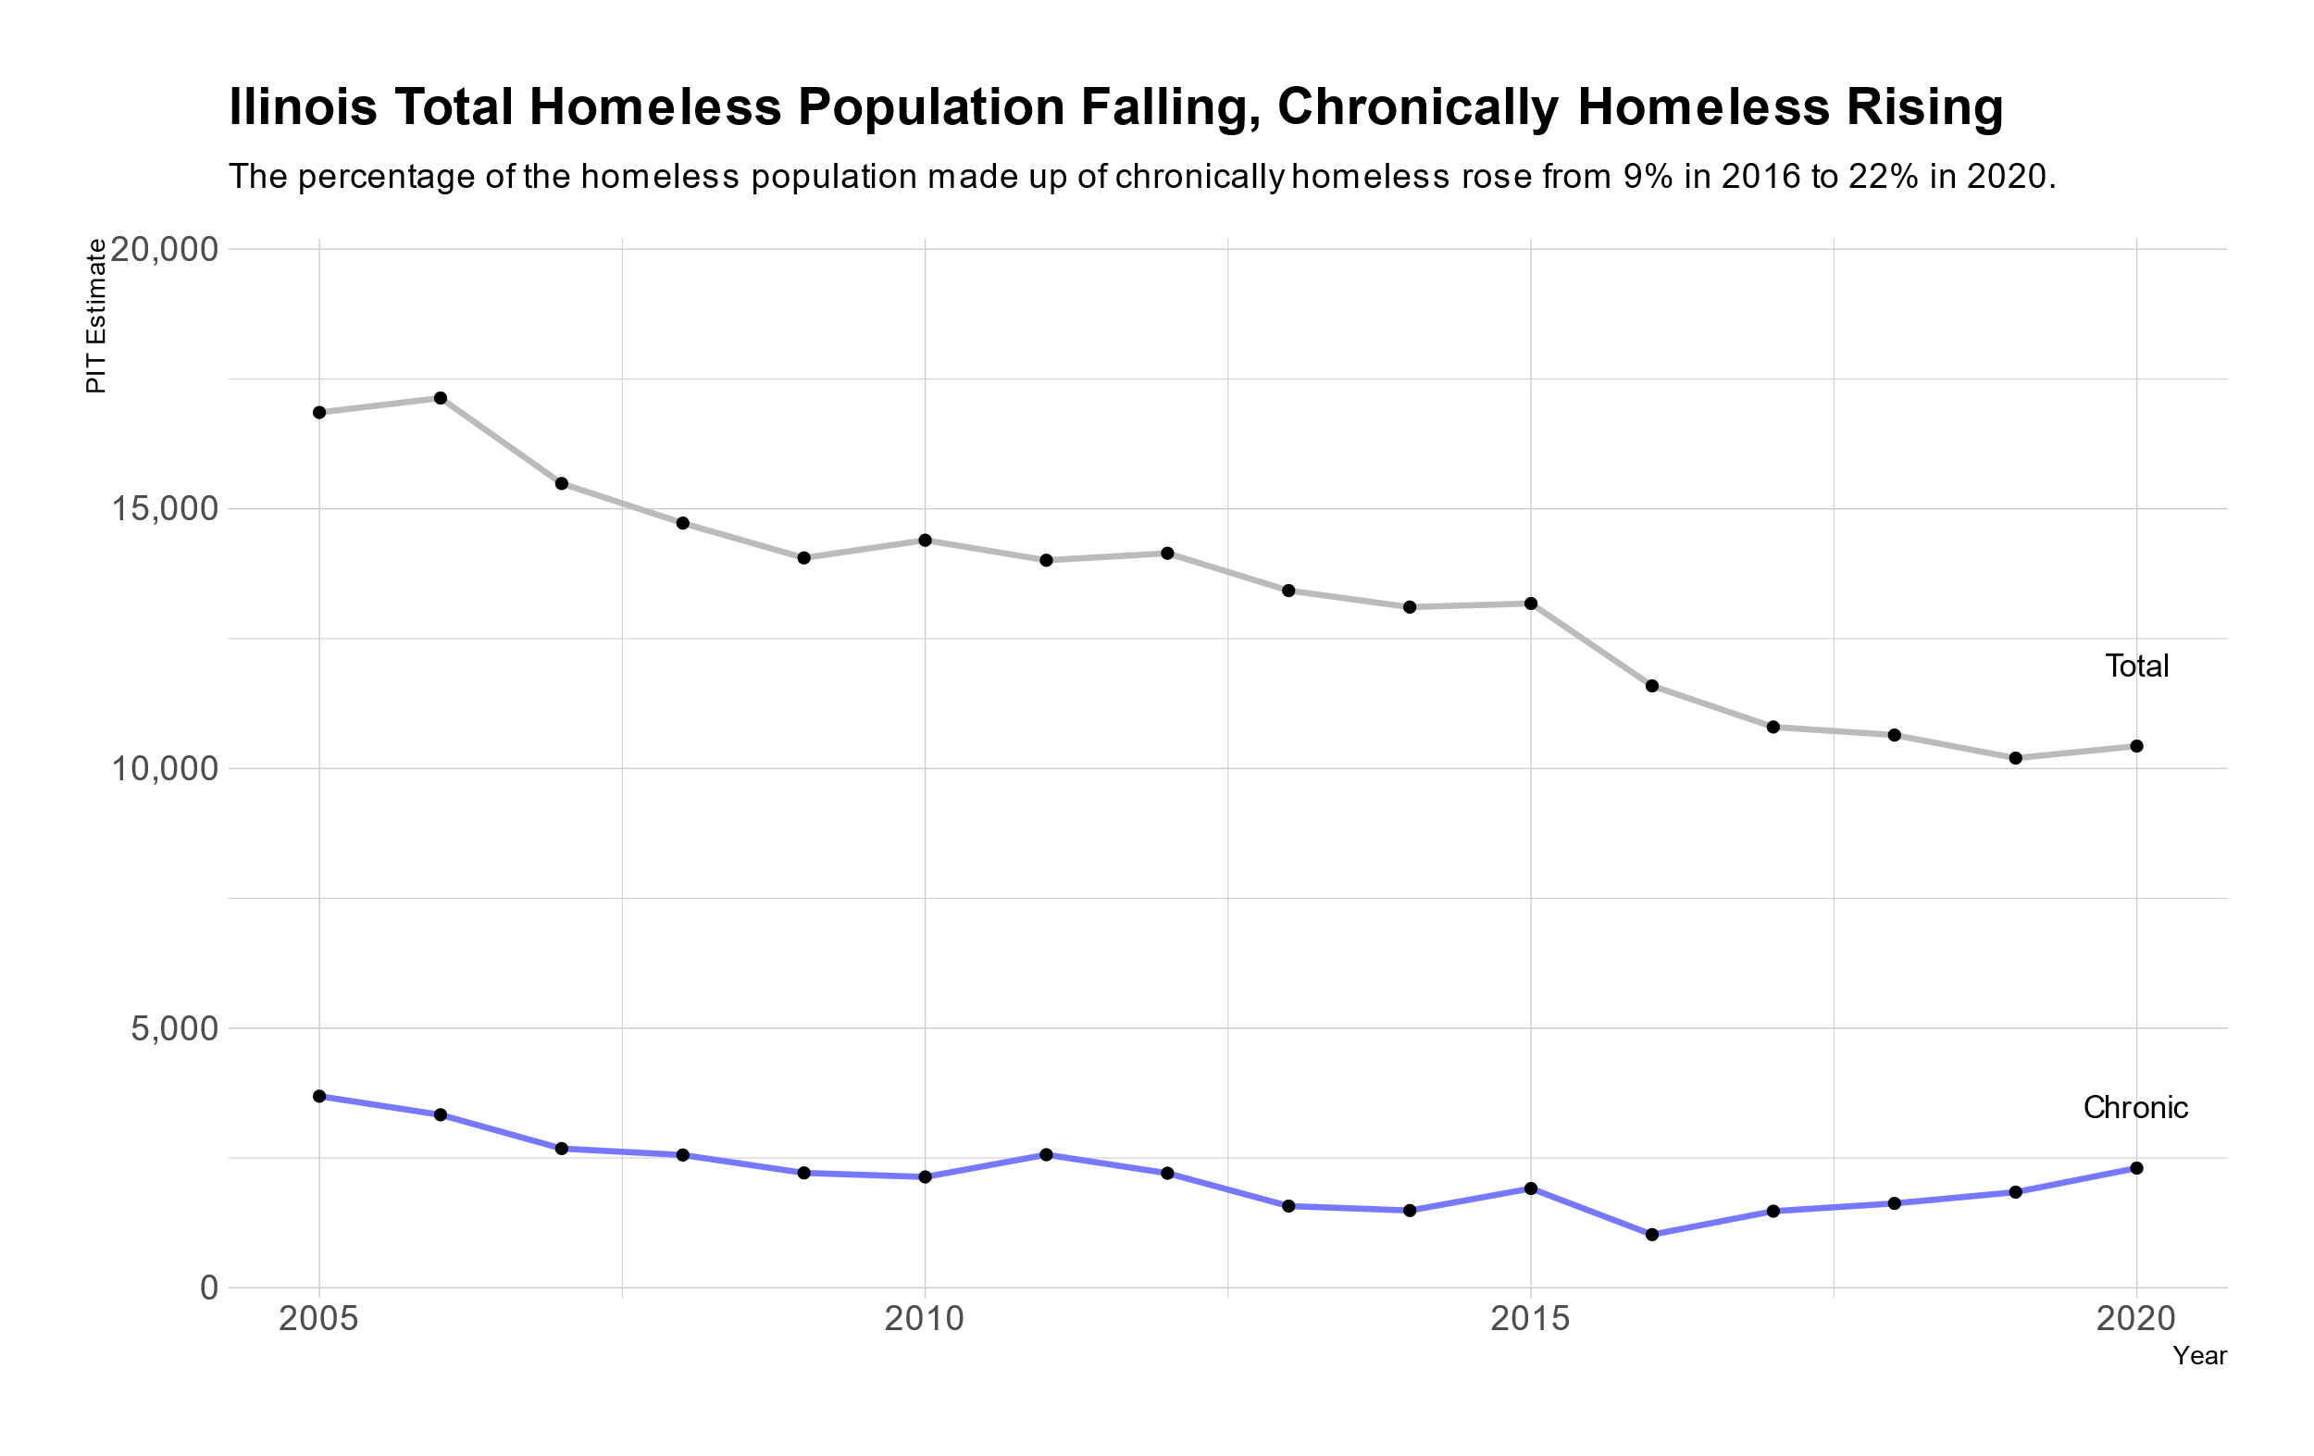
Current Landscape of Homelessness in Illinois
Notes:
Christine
Move needle on our chronic homeless (homeless 1+ year(s), disabled), “frequent flyers”

Slide 6
Executive Order 2021-21
Signed by Governor Pritzker on September 2021 & Codified in July 2023
Creates new homelessness infrastructure within State of Illinois government
  Interagency Task Force on Homelessness
  Community Advisory Council on Homelessness
  State Homelessness Chief & Illinois Office to Prevent & End Homelessness (OPEH)
Develop a State Plan and deliver to Governor Pritzker and the Illinois General Assembly by June 1 ,2022.
Prepare an annual report to the Governor and General Assembly by December 1st of each year with the first report delivered on December 1, 2022.
Notes:
Sol

Slide 7
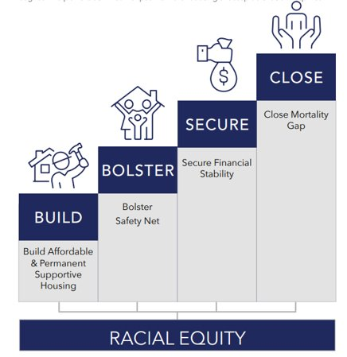
Home Illinois: A Proposed Plan and Budget to Reach Functional Zero
Plan to Prevent & End Homelessness:
Home Illinois Framework
Inventory of 100+ policy, program or process activities across 17 State agencies
Foundational goal: ending the racial disparity that exists in homelessness

Slide 8
What is a Continuum of Care?
A Continuum of Care (CoC) is a community wide policy and planning body on homelessness. CoCs are funded by and prepare a joint funding application for the US Department of Housing and Urban Development.
Representatives include: nonprofit homeless providers, victim service providers, faith-based organizations, governments, businesses, advocates, public housing agencies, school districts, social service providers, mental health agencies, hospitals, universities, affordable housing developers, law enforcement, organizations that serve homeless and formerly homeless veterans, and homeless and formerly homeless persons
Responsibilities include: operating the CoC, designating and operating an HMIS (Homeless Management Information System), planning for the CoC, and designating and implementing the process associated with applying for CoC Program Funds

Slide 9
